Slide 1
Analyzing Code in .NET
Jason Bock

Slide 2
Personal Info
http://www.jasonbock.net
https://www.twitter.com/jasonbock
https://www.github.com/jasonbock
https://www.youtube.com/c/JasonBock
jason.r.bock@outlook.com

Slide 3
Downloads
https://github.com/JasonBock/AnalyzingCodeInDotNet
https://github.com/JasonBock/Transpire
https://github.com/JasonBock/Presentations

Slide 4
Overview
Analysis
Building
Call to Action
Remember…
https://github.com/JasonBock/AnalyzingCodeInDotNet
https://github.com/JasonBock/Transpire
https://github.com/JasonBock/Presentations

Slide 5
Analysis

Slide 6

Notes:
Have you ever failed in public? It can be awkward, embarrassing, and when you’re building a project, it can be damaging in various ways. We have the best of intentions, and we are smart, intelligent folks. But we're fallible. Think of the Tacoma Narrows bridge, a famous example of engineering gone wrong.
http://www.tacomanarrowsbridge.org/z1940-100.jpg

Slide 7
Notes:
If there's a truism in code, it's that we'll write code that fails. And sometimes that happens spectacularly.
http://www.tacomanarrowsbridge.org/z1940-34.jpg

Slide 8
Notes:
Failing in production is something we want to avoid. One technique is to do manual code reviews, either as an individual or as a group.
https://www.pexels.com/photo/photo-of-people-doing-handshakes-3183197/

Slide 9
var source = /* reference to array */
var destination = new int[0];
foreach(var item in source)
{
var holder = new int[destination.Length + 1];
destination.CopyTo(holder, 0);
holder[destination.Length] = item;
destination = holder;
}
Notes:
Sometimes, it’s obvious when someone has written a train wreck. This code copies the contents of an array (source) to destination. But….all it needed to do was call:
source.CopyTo(destination, 0); // assume destination is the same size as source.
(Yes, this was code I found in a production app that had been live for at least 10 years. Copies of it were all over the place.)

Slide 10
Notes:
Other times, it’s much harder to see the bug.
https://unsplash.com/photos/_OyMf5BbAxA

Slide 11
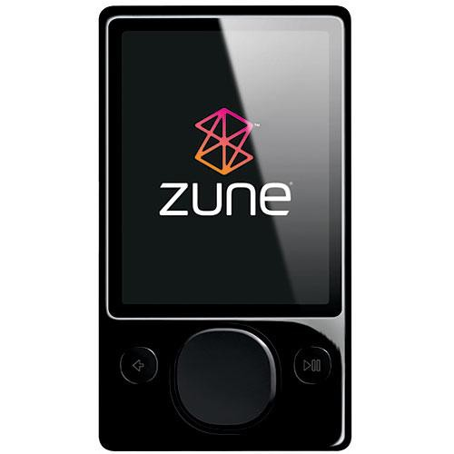
year = ORIGINYEAR; /* = 1980 */
while (days > 365)
{
if (IsLeapYear(year))
{
if (days > 366)
{
days -= 366;
year += 1;
}
}
else
{
days -= 365;
year += 1;
}
}
"A bug in the internal clock driver related to the way the device handles a leap year affected Zune users," said the company in a statement. “That being the case, the issue should be resolved over the next 24 hours as the time change moves to January 1, 2009."
Notes:
This code is from the Zune. Do you think you could’ve caught the error at first glance?
https://www.hanselman.com/blog/back-to-basics-explore-the-edge-cases-or-date-math-will-get-you
https://www.wired.com/2008/12/zune-freeze-res/

Slide 12

/* generated code */
if ( ++p == pe )
goto _test_eof;
The root cause of the bug was that reaching the end of a buffer was checked using the equality operator and a pointer was able to step past the end of the buffer. This is known as a buffer overrun. Had the check been done using >= instead of == jumping over the buffer end would have been caught.
Notes:
This is arguably even worse. Remember Cloudbleed?
https://blog.cloudflare.com/incident-report-on-memory-leak-caused-by-cloudflare-parser-bug/

Slide 13
Notes:
We want to run our code through a microscope to let us find these errors as quickly as possible.
https://unsplash.com/photos/L9EV3OogLh0

Slide 14


Notes:
One technique is testing. We can (and should) write tests for our code. They help exercise our code to do what we think it should do, and if we change code, it can detect regressions and unexpected failures.
https://nunit.org/
https://xunit.net/

Slide 15
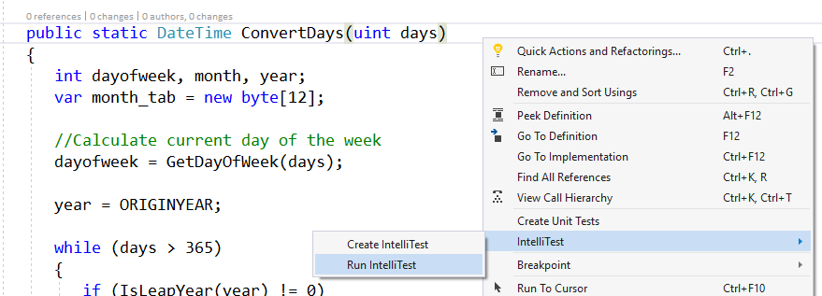
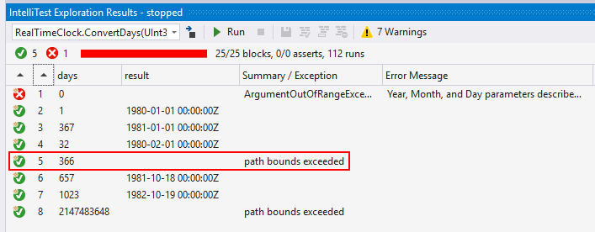
Notes:
We can also use Intellitest to generate tests for us and exercise our code's boundary conditions (show what happens with the Zune bug). Note that this requires Enterprise SKU and it only works on code targeting the .NET Framework, so that's probably not doable for everyone, but it is an option.

Slide 16
Notes:
I mentioned manual code reviews before. While they’re useful, humans can be frustrated, or sick, and we can miss things.
https://unsplash.com/photos/-2vD8lIhdnw

Slide 17
public Customer Get(int id) =>
new CustomerService().Get(id);
public class CustomerService
: IDisposable { /* ... */ }
Notes:
Would you be able to see this issue out of the gate with not disposing something that implements IDisposable?

Slide 18
if(Program.GetNames().Count() > 2
private static List<string> GetNames()
Notes:
Or this one? This should really use the “.Count” property, not the “.Count()” LINQ extension method.
(And yes, in .NET 6, this

Slide 19

“There are a finite number of keystrokes left in your hands before you die.” – Scott Hanselman
Notes:
We want to find issues as soon as we type code. The quote may be morbid, but it’s true!
https://www.hanselman.com/blog/do-they-deserve-the-gift-of-your-keystrokes
https://unsplash.com/photos/0gkw_9fy0eQ

Slide 20

write code
compile
code
static analysis tool
review results
Notes:
There are tools out there that can analyze your code. But the problem is the timing. The usually won't do anything until you successfully compile code. They only works at the assembly level.

Slide 21
write code
compile
code
static analysis tool
review results
Notes:
We want to move the needle, and do the analysis as soon as you make the mistake.

Slide 22
Notes:
Thankfully we now have the Compiler API, which allows us to write analyzers that can find issues as soon as you type.
https://user-images.githubusercontent.com/46729679/109719841-17b7dd00-7b5e-11eb-8f5e-87eb2d4d1be9.png

Slide 23
Roslyn Analyzers (https://github.com/dotnet/roslyn-analyzers)
SonarQube (https://www.sonarqube.org)
NDepend (https://www.ndepend.com)
DotNetAnalyzers (https://github.com/DotNetAnalyzers)
Code Cracker (https://code-cracker.github.io)
CodeIt.Right (https://submain.com/codeit.right/)
PVS Studio (https://www.viva64.com/en/pvs-studio/)
Coverity (https://scan.coverity.com)
Puma Scan (https://pumasecurity.io/)
And many others…
Notes:
Also: there are other products you can use. I won't show any of them here, but you are encouraged to check them out and evaluate them.

Slide 24
Demo: Analyzing Code with .editorconfig and Analyzers
Analyzing Code in .NET
Notes:
Let’s see how .editorconfig can affect code styles, and what happens when you add analyzers to a project and what they can find.

Slide 25
Notes:
So….that's great. You can write your own .editorconfig, and you can get analyzers from Nuget packages. But….what if you want to write your own?
https://unsplash.com/photos/y02jEX_B0O0

Slide 26
Demo: Writing an Analyzer and Code Fix
Analyzing Code in .NET
Notes:
Talk about Transpire, finding “new Guid()” and replacing with “Guid.NewGuid()”
Notes:
Get “.NET Compiler Platform SDK” from the VS Installer to get the Syntax Visualizer. (There is Syntax Visualizer for Rider, not sure if anything exists for VS Code)
You can use the “Analyzer with Code Fix” project template, which is good to see how stuff is set up, but it’s not required.
http://roslynquoter.azurewebsites.net/ can be used to generate syntax trees, which may be useful for code fixes.

Slide 27
Call To Action

Slide 28
Notes:
My “call to action” to you is this: climb the mountain. Using code analysis tools may be straightforward but writing them may seem daunting.
https://unsplash.com/photos/5x4U6InVXpc

Slide 29
Notes:
If you stick with it, you’ll have a great view of your code.
https://unsplash.com/photos/z0nVqfrOqWA

Slide 30

Notes:
Using analyzers and being able to write your own – those are powerful tools. I strongly encourage you to use ones that exist and create your own for cases you’re running into with your own code.
https://unsplash.com/photos/t5YUoHW6zRo

Slide 31
Analyzing Code in .NET
Jason Bock
Remember…
https://github.com/JasonBock/AnalyzingCodeInDotNet
https://github.com/JasonBock/Transpire
https://github.com/JasonBock/Presentations
References in the notes on this slide
Notes:
## References
* [Overview of .NET source code analysis](https://docs.microsoft.com/en-us/dotnet/fundamentals/code-analysis/overview)
* [The Roslyn analyzers I use in my projects](https://www.meziantou.net/the-roslyn-analyzers-i-use.htm)
* [ANALYZING CODE FOR ISSUES IN .NET 5](https://dotnettips.wordpress.com/2021/01/14/analyzing-code-for-issues-in-net-5/)
* [Static analysis for .NET 5](https://github.com/dotnet/runtime/issues/30740)
* [A Few Billion Lines of Code Later: Using Static Analysis to Find Bugs in the Real World](https://m-cacm.acm.org/magazines/2010/2/69354-a-few-billion-lines-of-code-later/fulltext)
* [Awesome Roslyn](https://github.com/ironcev/awesome-roslyn/blob/master/readme.md)
* [Welcome to roslyn-analyzers documentation](https://roslyn-analyzers.readthedocs.io/en/latest/)
* [Treat Warnings As Errors. I Mean It. You Need to Do This](https://blog.submain.com/treat-warnings-errors/)
* [Raffaele Rialdi — Write your own C# static code analysis tool to drive business rules](https://www.youtube.com/watch?v=HT7k3Qm4uFY)
* [16 New Code Analysis, Testing and Debugging Tools For Visual Studio 2017](https://visualstudiomagazine.com/articles/2018/05/01/vs-analysis-tools.aspx)
* [.NET Development Using the Compiler API](https://www.apress.com/us/book/9781484221105)
* [Automating Code Reviews in .NET](https://magenic.com/media/2669/automating-code-reviews-in-net.pdf)
* [Roslyn Analyzer IDs Problem .NET Core, .NET Standard APIs](https://visualstudiomagazine.com/articles/2017/11/07/api-analyzer.aspx)
* [Rigging up Roslyn Analyzers in .NET Core](https://blogs.msdn.microsoft.com/devfish/2017/11/09/rigging-up-roslyn-analyzers-in-net-core/)
* [Your New Virtual API Review Assistant](https://channel9.msdn.com/coding4fun/blog/Your-New-Virtual-API-Review-Assistant)
* [Code Analysis, Profiling and Refactoring Tools for Visual Studio 2017](https://visualstudiomagazine.com/Articles/2017/10/01/Code-Analysis.aspx)
* [Hands-free Security Scanning within .NET Applications](http://rion.io/2017/10/02/hands-free-security-scanning-within-net-applications/)
* [Amazon Says One Engineer's Simple Mistake Brought the Internet Down](https://gizmodo.com/amazon-says-one-engineers-simple-mistake-brought-the-in-1792907038)
* [Summary of the Amazon S3 Service Disruption in the Northern Virginia (US-EAST-1) Region](https://aws.amazon.com/message/41926)
* [Everything You Need to Know About Cloudbleed, the Latest Internet Security Disaster](http://gizmodo.com/everything-you-need-to-know-about-cloudbleed-the-lates-1792710616)
* [Incident report on memory leak caused by Cloudflare parser bug](https://blog.cloudflare.com/incident-report-on-memory-leak-caused-by-cloudflare-parser-bug/)
* [Windows Azure storage issue: Expired HTTPS certificate possibly at fault](http://www.zdnet.com/article/windows-azure-storage-issue-expired-https-certificate-possibly-at-fault/)
* [Windows Azure Service Disruption from Expired Certificate](https://azure.microsoft.com/en-us/blog/windows-azure-service-disruption-from-expired-certificate/)
* [Back to Basics: Explore the Edge Cases or Date Math will Get You](https://www.hanselman.com/blog/back-to-basics-explore-the-edge-cases-or-date-math-will-get-you)
* [Zune bug explained in detail](https://techcrunch.com/2008/12/31/zune-bug-explained-in-detail/)

